Slide 1

Apple (NASDAQ) daily Stock Price Analysis

Slide 2
Introduction
This dataset is scraped from the Alpha Vantage API which provides real-time and historical data of stock market prices.
I scraped the data in Python using the Alpha Vantage API.
In data scrapping, Symbol which is used is “APPL”
"AAPL", is the stock symbol for Apple Inc., an American multinational technology company that designs, develops, and sells consumer electronics, computer software, and online services.
Tools that I used during this analysis are Python and Excel.

Slide 3

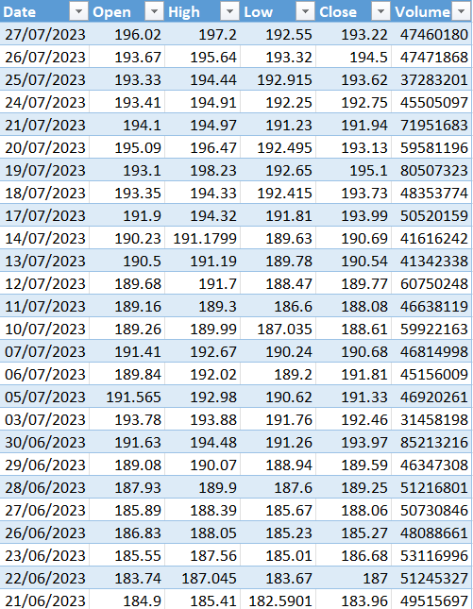
A Glance of the dataset
This real-time dataset is comprised of 5 months from Mar-2023 to July 2023. It has 6 variables date, open, high, low, close, and volume.
Variables for Apple stock market under NASDAQ, we can define in the following way:
Open: The opening price of AAPL stock on a given trading day
High: The highest price that AAPL stock reached on a given trading day
Low: The lowest price that AAPL stock reached on a given trading day
Close: The closing price of AAPL stock on a given trading day
Volume: The total number of shares of AAPL stock that were traded on a given trading day on NASDAQ

Slide 4
The approach used for analysis
We will explore the dataset by using the following approach:
Descriptive Statistics
Distribution of Variables
Correlation between Variables
Visual representation of the correlation between variables
Trend analysis of time-series data
Pivot table for examining the average open, high, low, close, and volume
Hypothesis Testing

Slide 5
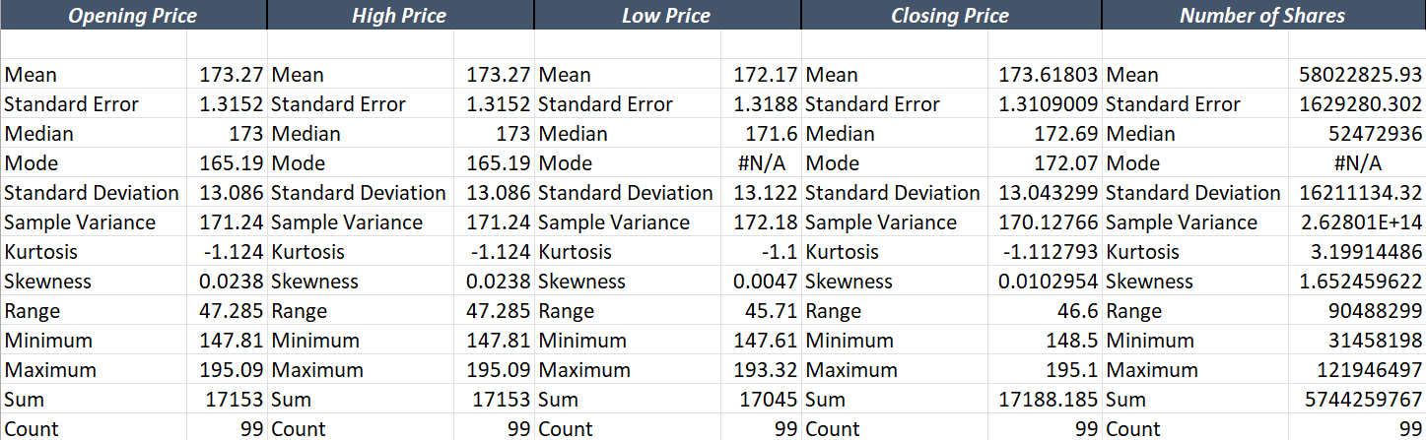
Descriptive statistics
Apple product’s average opening price is $173, minimum opening price is $148 and maximum opening price is $195
Apple product’s average high price is $173, minimum high price is $148 and maximum high price is $195
Apple product’s average low price is $172, minimum opening price is $148 and maximum opening price is $193
Apple product’s average closing price is $173, minimum closing price is $148 and maximum closing price is $195
Apple product’s average number of shares is 58M, minimum share is 31M and maximum share is 121M

Slide 6
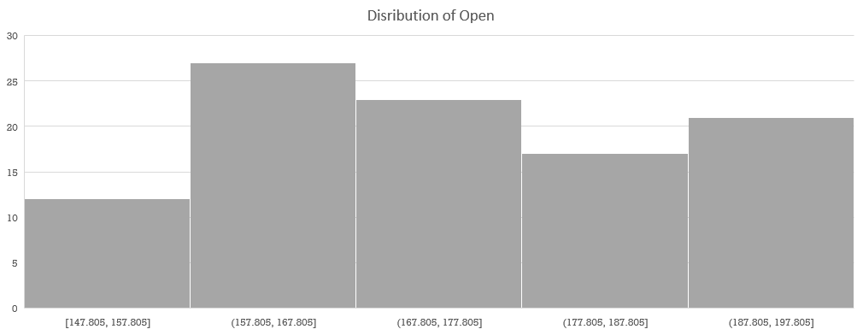
Distribution of variables

Slide 7
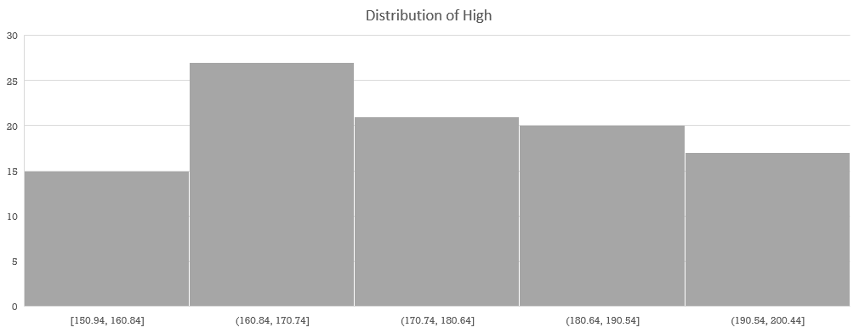
Distribution of variables

Slide 8
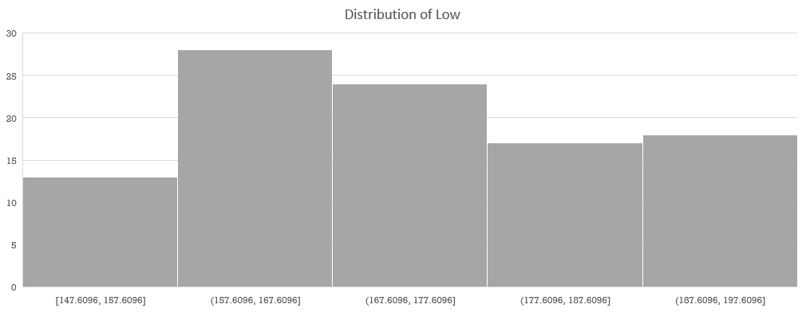
Distribution of variables

Slide 9
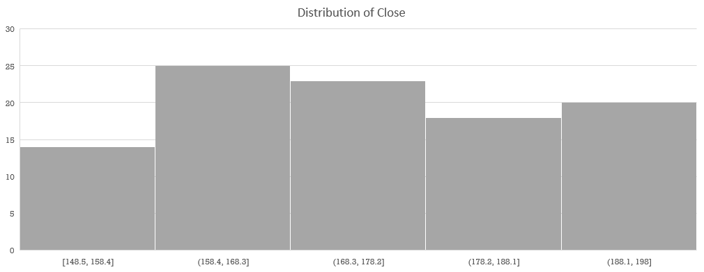
Distribution of variables

Slide 10
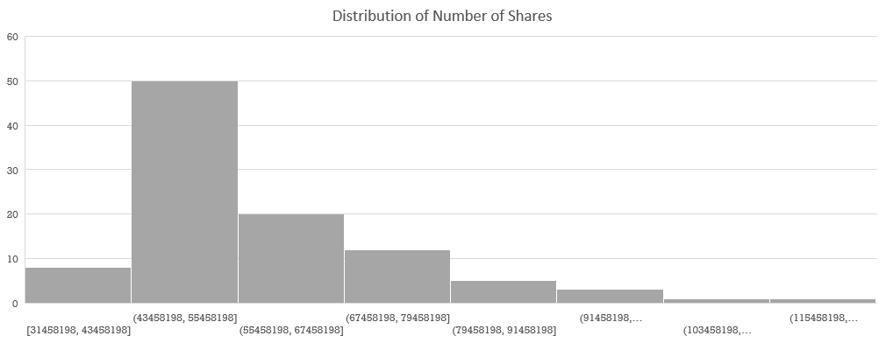
Distribution of variables

Slide 11
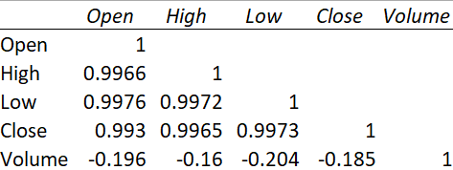
Correlation between variables
There is a very strong positive correlation between the "Open", "High", "Low", and "Close" columns, with correlation coefficients ranging from 0.993 to 0.997.
This suggests that these variables are highly related to each other and tend to move in the same direction.

Slide 12
Correlation between variables
We can see that there is a weak negative correlation between the "Volume" column and the other columns, with correlation coefficients ranging from -0.16 to -0.2.
This suggests that there is a weak relationship between the volume of trades and the stock prices. It means changes in trading volume don't have as much of an impact on the stock prices.

Slide 13
Visual representation of correlation

Slide 14
Visual representation of correlation

Slide 15
Visual representation of correlation

Slide 16
Trend analysis of time-series data
There is an increasing trend in stock prices of Apple products from Mar-2023 to July 2023

Slide 17
Trend analysis of time-series data
The majority number of shares which is volume is in the range from 43M to 80M.

Slide 18
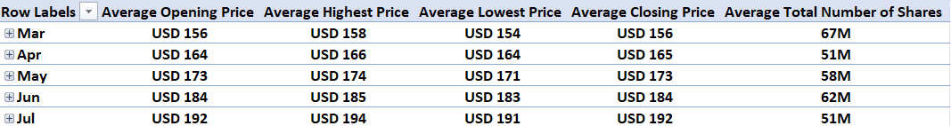
Pivot table for examining average prices and volume
In Mar-2023 average prices are between $156- $158 and shares are 67M
In Apr-2023 average prices are between $164- $166 and shares are 51M
In May-2023 average prices are between $171- $174 and shares are 58M
In Jun-2023 average prices are between $183 - $185 and shares are 62M
In July-2023 average prices are between $191 - $194 and shares are 51M

Slide 19
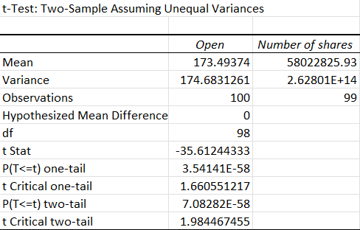
Hypothesis testing
Hypothesis:
Is the opening price impact the number of shares?
Statistical Results:
Results are statistically significant. It rejects the null hypothesis
Interpretation:
Opening price has no impact on the number of shares.

